Slide 1
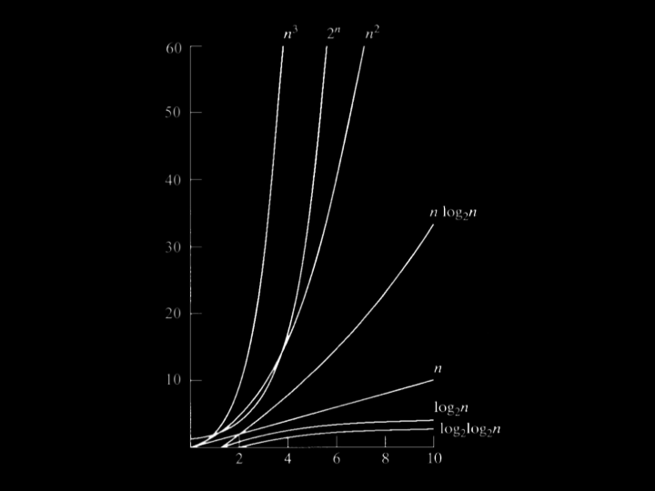

Slide 2
O(n²)
O(n log n)
O(n)
O(log n)
O(1)

Slide 3
Sorting Algorithms

Slide 4
Bubble Sort
Insertion Sort
Shell Sort
Quick Sort
Merge Sort
Heap Sort
Selection Sort

Slide 5
input →
→ output

Slide 6
unsorted →
→ output

Slide 7
unsorted →
→ sorted

Slide 8
→
→ sorted
6 3 8 5 2 7 4 1

Slide 9
→
→
6 3 8 5 2 7 4 1
1 2 3 4 5 6 7 8

Slide 10
selection sort
Notes:
6 3 8 5 2 7 4 1

Slide 11
6 3 8 5 2 7 4 1

Slide 12
For i from 0 to n-1
Find smallest item between i'th item and last item
Swap smallest item with i'th item
Notes:
https://www.cs.usfca.edu/~galles/visualization/ComparisonSort.html

Slide 14
n

Slide 15
n + (n – 1)

Slide 16
n + (n – 1) + (n – 2)

Slide 17
n + (n – 1) + (n – 2) + ... + 1

Slide 18
n + (n – 1) + (n – 2) + ... + 1
n(n + 1)/2

Slide 19
n + (n – 1) + (n – 2) + ... + 1
n(n + 1)/2
(n² + n)/2

Slide 20
n + (n – 1) + (n – 2) + ... + 1
n(n + 1)/2
(n² + n)/2
n²/2 + n/2

Slide 21
n + (n – 1) + (n – 2) + ... + 1
n(n + 1)/2
(n² + n)/2
n²/2 + n/2
O(n²)

Slide 22
O(n²)
O(n log n)
O(n) linear search
O(log n) binary search
O(1)

Slide 23
O(n²) selection sort
O(n log n)
O(n) linear search
O(log n) binary search
O(1)

Slide 24
For i from 0 to n-1
Find smallest item between i'th item and last item
Swap smallest item with i'th item

Slide 25
Ω(n²)
Ω(n log n)
Ω(n)
Ω(log n)
Ω(1) linear search, binary search

Slide 26
Ω(n²) selection sort
Ω(n log n)
Ω(n)
Ω(log n)
Ω(1) linear search, binary search

Slide 27
bubble sort
Notes:
6 3 8 5 2 7 4 1

Slide 28
6 3 8 5 2 7 4 1

Slide 29
Bubble Sort
An idea of this algorithm is to move higher valued elements generally towards the right and lower elements generally towards the left.
In pseudocode:
Set swap counter to non-zero value
Repeat until the swap counter is 0:
Reset swap counter to 0
Look at each adjacent pair
If the adjacent elements are not in order, swap them and add one to swap counter.

Slide 30
Repeat until sorted
For i from 0 to n-2
If i'th and i+1'th elements out of order
Swap them

Slide 31
Repeat n-1 times
For i from 0 to n-2
If i'th and i+1'th elements out of order
Swap them
Notes:
https://www.cs.usfca.edu/~galles/visualization/ComparisonSort.html

Slide 33
(n – 1) × (n – 1)

Slide 34
(n – 1) × (n – 1)
n² – 1n – 1n + 1

Slide 35
(n – 1) × (n – 1)
n² – 1n – 1n + 1
n² – 2n + 1

Slide 36
(n – 1) × (n – 1)
n² – 1n – 1n + 1
n² – 2n + 1
O(n²)

Slide 37
O(n²) selection sort
O(n log n)
O(n) linear search
O(log n) binary search
O(1)

Slide 38
O(n²) selection sort, bubble sort
O(n log n)
O(n) linear search
O(log n) binary search
O(1)

Slide 39
Repeat n-1 times
For i from 0 to n-2
If i'th and i+1'th elements out of order
Swap them
If no swaps
Quit

Slide 40
Bubble Sort Demo
Swap Counter
-1
6 | 5 | 8 | 2 | 4 | 1

Slide 41
Swap Counter
0
6 | 5 | 8 | 2 | 4 | 1

Slide 42
Swap Counter
1
5 | 6 | 8 | 2 | 4 | 1

Slide 43
Swap Counter
1
5 | 6 | 8 | 2 | 4 | 1

Slide 44
Swap Counter
2
5 | 6 | 2 | 8 | 4 | 1

Slide 45
Swap Counter
3
5 | 6 | 2 | 4 | 8 | 1

Slide 46
Swap Counter
4
5 | 6 | 2 | 4 | 1 | 8

Slide 47
Swap Counter
4
5 | 6 | 2 | 4 | 1 | 8

Slide 48
Swap Counter
0
5 | 6 | 2 | 4 | 1 | 8

Slide 49
Swap Counter
0
5 | 6 | 2 | 4 | 1 | 8

Slide 50
Swap Counter
1
5 | 2 | 6 | 4 | 1 | 8

Slide 51
Swap Counter
2
5 | 2 | 4 | 6 | 1 | 8

Slide 52
Swap Counter
3
5 | 2 | 4 | 1 | 6 | 8

Slide 53
Swap Counter
3
5 | 2 | 4 | 1 | 6 | 8

Slide 54
Swap Counter
0
5 | 2 | 4 | 1 | 6 | 8

Slide 55
Swap Counter
1
2 | 5 | 4 | 1 | 6 | 8

Slide 56
Swap Counter
2
2 | 4 | 5 | 1 | 6 | 8

Slide 57
Swap Counter
3
2 | 4 | 1 | 5 | 6 | 8

Slide 58
Swap Counter
3
2 | 4 | 1 | 5 | 6 | 8

Slide 59
Swap Counter
0
2 | 4 | 1 | 5 | 6 | 8

Slide 60
Swap Counter
0
2 | 4 | 1 | 5 | 6 | 8

Slide 61
Swap Counter
1
2 | 1 | 4 | 5 | 6 | 8

Slide 62
Swap Counter
1
2 | 1 | 4 | 5 | 6 | 8

Slide 63
Swap Counter
0
2 | 1 | 4 | 5 | 6 | 8

Slide 64
Swap Counter
1
1 | 2 | 4 | 5 | 6 | 8

Slide 65
Swap Counter
1
1 | 2 | 4 | 5 | 6 | 8

Slide 66
Swap Counter
0
1 | 2 | 4 | 5 | 6 | 8

Slide 67
Ω(n²) selection sort
Ω(n log n)
Ω(n)
Ω(log n)
Ω(1) linear search, binary search

Slide 68
Ω(n²) selection sort
Ω(n log n)
Ω(n) bubble sort(When array is sorted)
Ω(log n)
Ω(1) linear search, binary search

